Slide 1
Transect Level ROV Index of Abundance for Copper Rockfish
Dr. John Budrick, CDFW
Dr. Nick Perkins, University of Tasmania
Mike Prall, CDFW
Mike Patton, CDFW

Slide 2
Overview
Presentations to NMFS identified a preference for a transect level analysis with site as a random effect.
Random effect selected given feedback from the methodology review and the selected sites are among many potential sites and sampling proceeds on a randomized basis within a site.
Fixed effect might have less variance.
Appropriate scale given 8 to 12 scale of autocorrelation and addresses the unequal sampling of sites.
Draft indices provided for review by the March 13th deadline
Feedback from a review by Owen Hamel and John Field
Responded to input.
Revised model incorporating an interaction term for superyear and protection status as it the effect of closure varies with time.

Slide 3
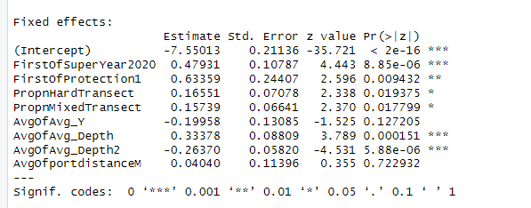
Model Overview
10 m segments were aggregated to the transect level
The log of seafloor area observed was included as an “offset” as the denominator for density in the dependent variable (fish/squrare meter).
Site level variable as a random effect
Generalized linear mixed model fit by maximum likelihood
Negagive binomial error distribution with log link
Continuous variables were scaled prior to analysis by centering on the mean and dividing by the standard deviation.
Different scales more compable
Facilitates estimation of index values.
Means and confidence intervals back calculated assuming all other covariates are at the mean value.
Model Selection Criteria
AIC
Stepwise removal
Deviance
Pseudo R square

Slide 4
Northern Model
Full Model AIC =2828
Latitude, years since protection and distance to port dropped out. Subsumed by Site?
Selected Model =2626.6
Interaction Term =2622.6
Estimate Std. Error z value Pr(>|z|)
(Intercept) -7.30280 0.22112 -33.027 < 2e-16 ***
FirstOfSuperYear2020 0.15844 0.17004 0.932 0.35145
FirstOfProtection1 0.27551 0.28207 0.977 0.32869
PropnHardTransect 0.17225 0.07032 2.450 0.01430 *
PropnMixedTransect 0.16163 0.06595 2.451 0.01426 *
AvgOfAvg_Depth 0.32839 0.08699 3.775 0.00016 ***
AvgOfAvg_Depth2 -0.25088 0.05763 -4.353 1.34e-05 ***
FirstOfSuperYear2020: 0.53524 0.21800 2.455 0.01408 *
FirstOfProtection1
Signif. codes: 0 ‘***’ 0.001 ‘**’ 0.01 ‘*’ 0.05 ‘.’ 0.1 ‘ ’ 1

Slide 5
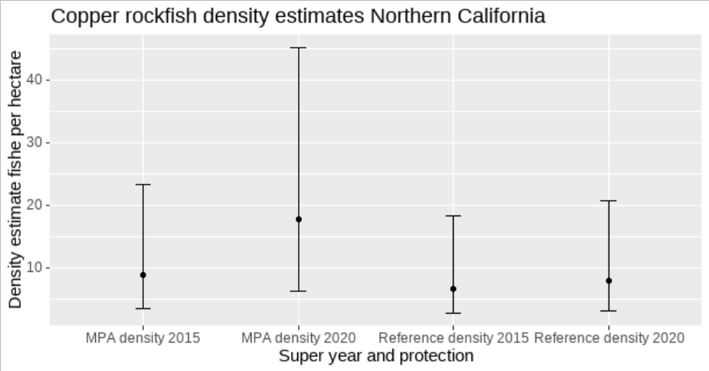
Northern Model Results
Results are consistent with or without the interaction term.
Increasing trend inside and outside MPAs
Habitat weighted average index.
2015 |  |  |  |  | 2020
Area | Index | Weight | Index*Weight |  | Area | Index | Weight | Index*Weight
Open | 6.73652 | 0.8 | 5.389212 |  | Open | 7.893062 | 0.8 | 6.3144496
MPA | 8.8734 | 0.2 | 1.7746792 |  | MPA | 17.7563 | 0.2 | 3.5512594
 |  | Sum | 7.1638912 |  |  |  | Sum | 9.865709

Slide 6
Southern Model
Full Model AIC =3062.7
Latitude, years since protection and distance to port dropped out. Subsumed by Site?
Selected Model =3059.4
Interaction Term =3061.3
Estimate Std. Error z value Pr(>|z|)
(Intercept) -5.83201 0.18147 -32.138 < 2e-16 ***
FirstOfSuperYear2020 -0.14634 0.12687 -1.153 0.248730
FirstOfProtection1 0.78301 0.22183 3.530 0.000416 ***
PropnHardTransect 0.17304 0.05115 3.383 0.000717 ***
PropnMixedTransect 0.21679 0.04597 4.716 2.41e-06 ***
AvgOfAvg_X -0.48124 0.10950 -4.395 1.11e-05 ***
AvgOfAvg_Depth 0.31100 0.07324 4.247 2.17e-05 ***
AvgOfAvg_Depth2 -0.31262 0.06030 -5.184 2.17e-07 ***
FirstOfSuperYear2020: 0.03502 0.15198 0.230 0.817764
FirstOfProtection1
Signif. codes: 0 ‘***’ 0.001 ‘**’ 0.01 ‘*’ 0.05 ‘.’ 0.1 ‘ ’ 1

Slide 7
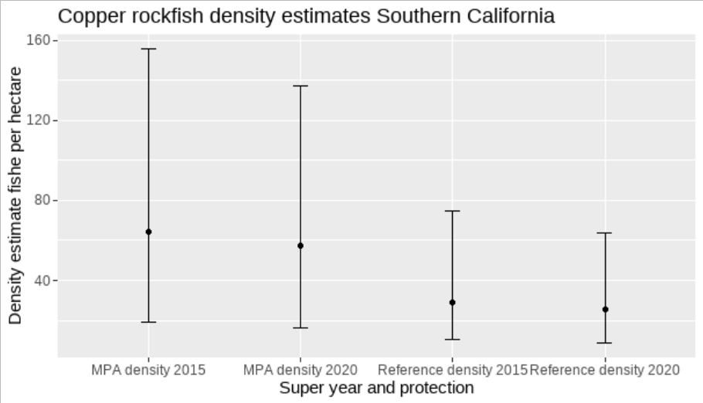
Southern Model Results
Results are consistent with or without the interaction term.
Increasing trend inside and outside MPAs
Habitat weighted average index.
2015 |  |  |  |  | 2020
Area | Index | Weight | Index*Weight |  | Area | Index | Weight | Index*Weight
Open | 29.32182 | 0.92 | 26.9760744 |  | Open | 25.33013 | 0.92 | 23.3037196
MPA | 64.15787 | 0.08 | 5.1326296 |  | MPA | 57.39913 | 0.08 | 4.5919304
 |  | Sum | 32.108704 |  |  |  | Sum | 27.89565

Slide 8
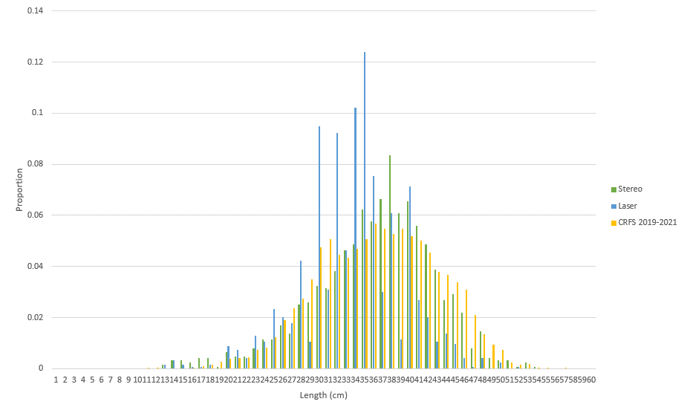
Length Data

Slide 9
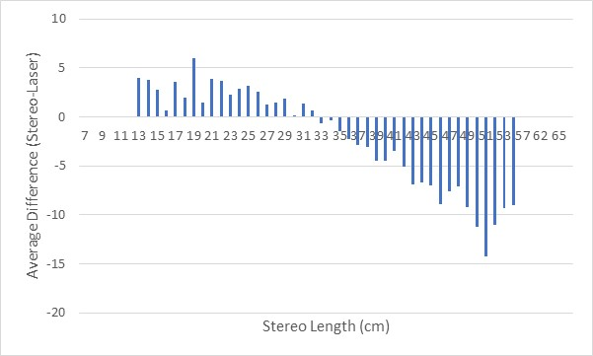
Stereo Camera Lengths vs. Paired Laser Approximations

Slide 10
Lengths Available
MARE processed 2020 Super Year
Still working through 2015 Super Year – Count as of 3/22.
50% can be measured
Timeline mid April
Assessment Area | Currently Available |  | To Process |  | Anticipated Usable
 | 2015 | 2020 | 2015 | 2020 | 2015 | 2020
North | 72 | 377 | 138 | 0 | 141 | 377
South | 8 | 857 | 1337 | 0 | 677 | 857

Slide 11
Next Steps
Revisions to indices.
Additional diagnostics?
All lengths available by mid April?

